Slide 1
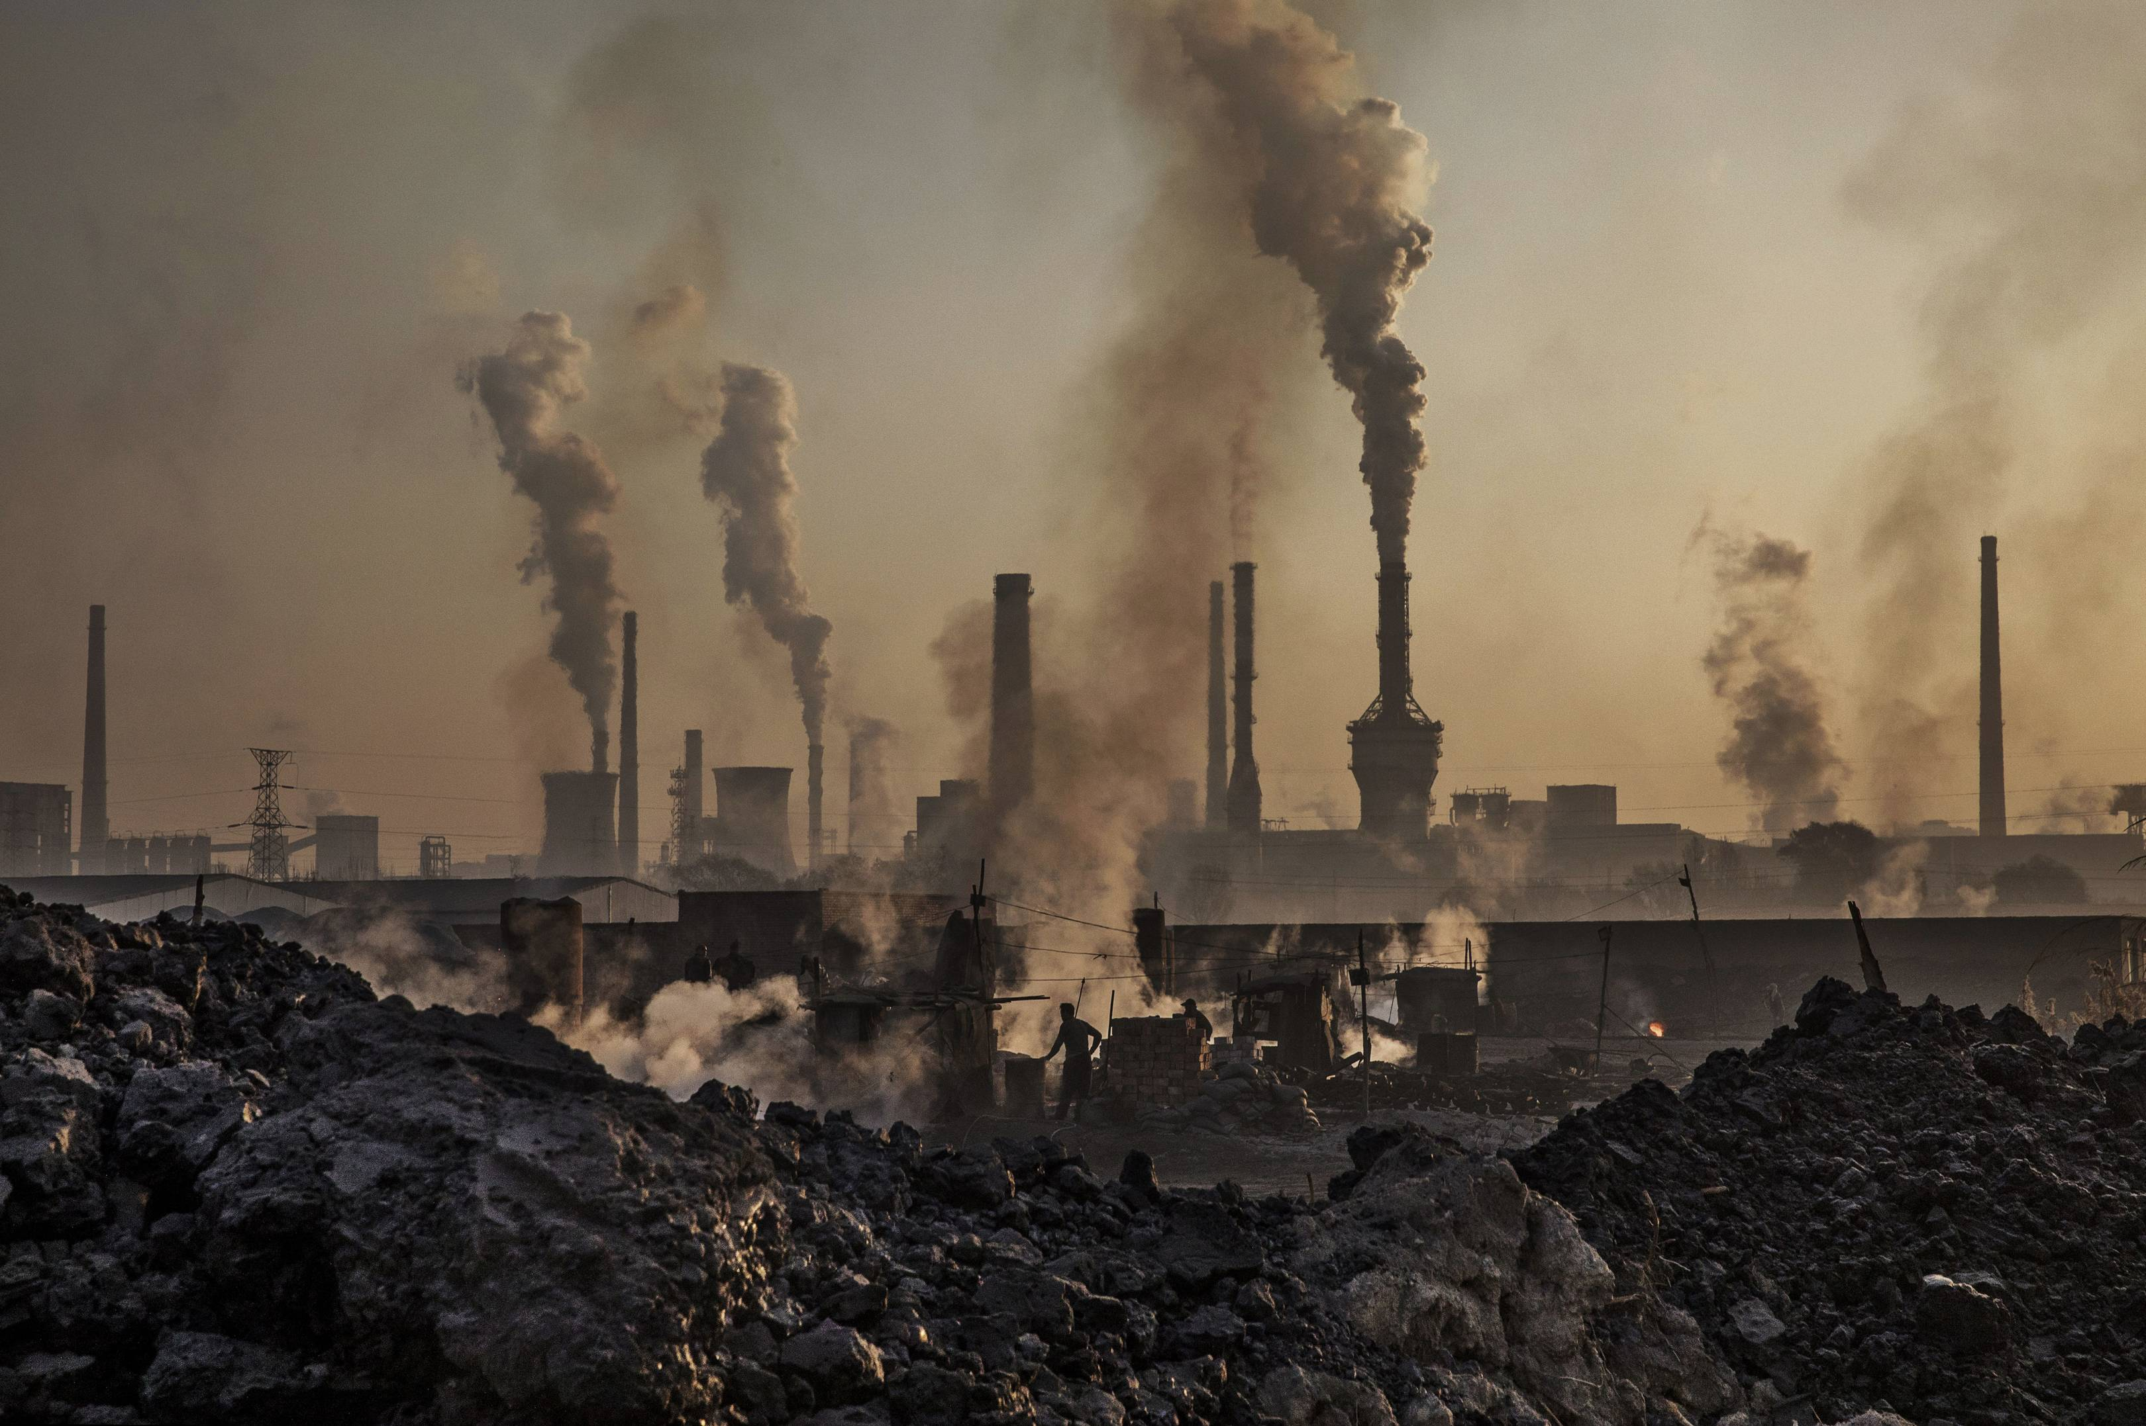
Environment Pollution
This Photo by Unknown Author is licensed under CC BY-SA

Slide 2
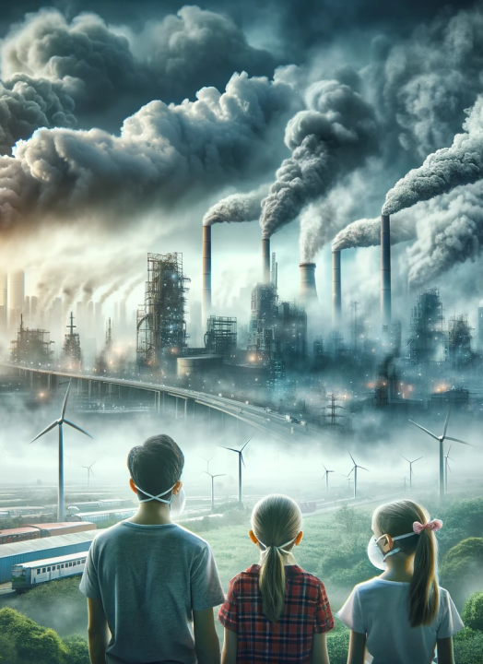
Introduction * Environment pollution refer to the contamination of the environment due to harmful substances and activities. Addressing pollution is crucial for the well- being of humans, wildlife, and the planet.

Slide 3
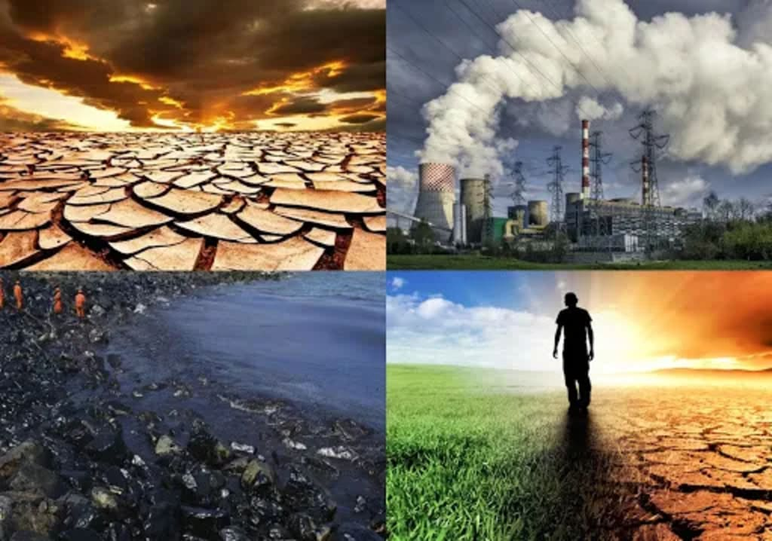
Types of pollution
Air pollution
water pollution
Soil pollution
Noise pollution

Slide 4
Causes of Pollution
Industrialization
Urbanization
Deforestation
Improper waste Management

Slide 5
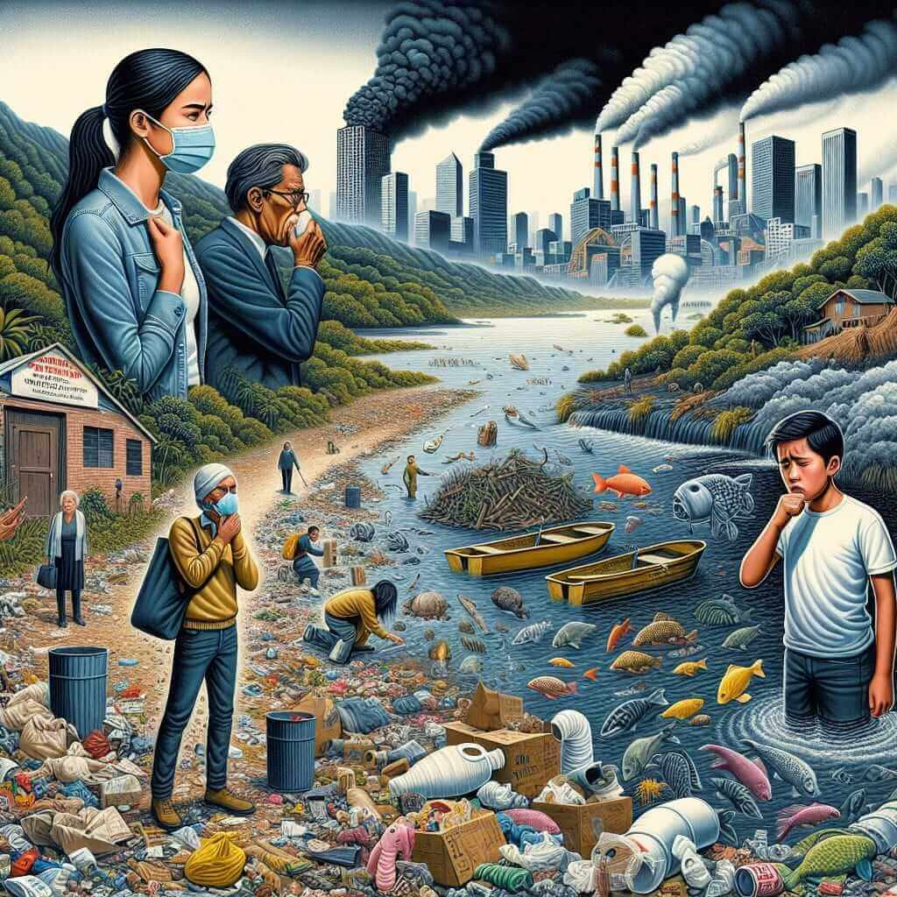
Effects of Pollution
Human health: Respiratory issues, diseases.
Wildlife: Habitat loss, species extinction
Environment: climate change, ecological
imbalance.

Slide 6
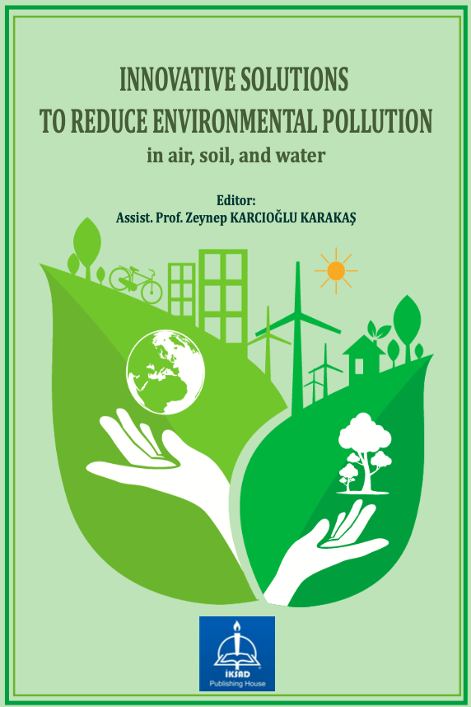
Solutions to Pollution
Use renewable energy sources.
Implement recycling and waste management.
Raise public awareness.
Enforce government regulations.

Slide 7
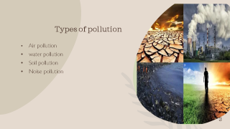

Conclusion and call to action
Environmental pollution is a critical issue that demands immediate action. Each individual and community can contribute to reducing pollution and preserving the environment for future generations.

